Slide 1
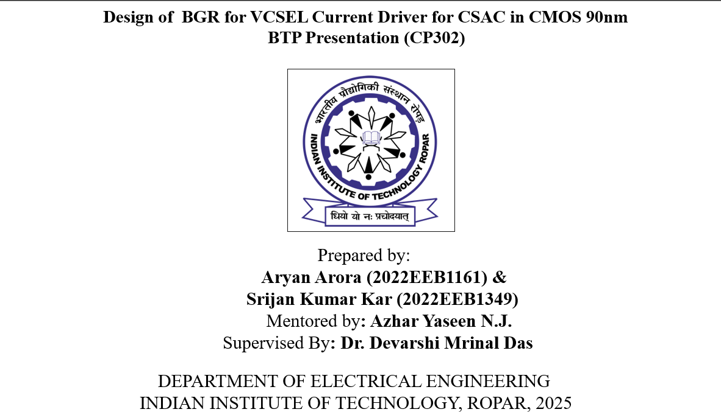

Slide 2
CSAC Introduction
A Chip-Scale Atomic Clock (CSAC) is a miniaturized atomic clock that provides highly accurate timekeeping in a compact, low-power package.
It is based on atomic resonance principles including coherent population trapping (CPT) techniques. CSACs are widely used in applications where precise timing is essential, such as GPS-denied navigation, secure communications, and scientific measurements.
Desired Characteristics of CSAC
High Accuracy – Provides precise timekeeping with minimal drift, featuring a frequency stability of 2.2 × 10⁻¹² over 10⁵ seconds.
Miniaturized Size – Compact form factor, suitable for portable and embedded systems, with a volume as small as 15 cm³.
Low Power Consumption –Operates with very low power, consuming up to 59.9 mW.
Resistance to Environmental Factors – Performs reliably under varying temperatures, vibrations, and electromagnetic conditions.
Reference: H. Zhang et al., “Ultra-Low-Power Atomic Clock for Satellite Constellation Using Cesium CPT,” ISSCC, 2019, pp. 462–464

Slide 3
Performance Edge of CSAC over Traditional Methods
Chip-Scale Atomic Clocks (CSACs) use quantum atomic resonance, locking frequency to the fundamental atomic transition of Cs-133 at 9.192631770 GHz [4], unlike Quartz/MEMS which rely on mechanical vibrations prone to drift from aging, temperature, and stress.
Atomic transitions offer an intrinsically stable reference with high Q-factor, resulting in much lower short-term frequency noise and Allan deviation (ADEV) values around 6.8786x10⁻¹² [4], compared to quartz oscillators' 10⁻⁹ to 10⁻⁸. CSACs also achieve ultra-low size and power consumption (under 100 mW and 10–20 cm³), making them 10–50 times more power-efficient and 5–50 times smaller than traditional rubidium clocks [5].
Reference:[3] H. Zhang et al., “Ultra-Low-Power Atomic Clock for Satellite Constellation Using Cesium CPT,” ISSCC, 2019, pp. 462–464

Slide 4
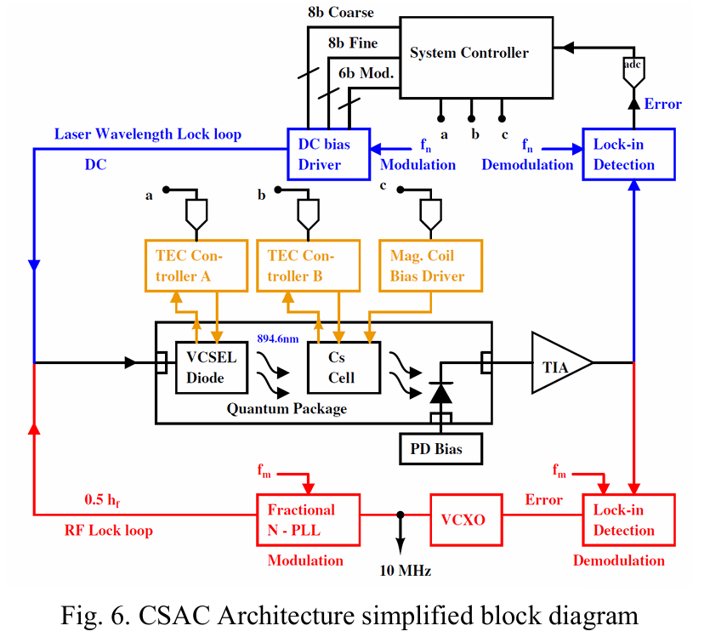
Architecture of CSAC
Fig.1 CSAC Architecture simplified block diagram
Reference: Azhar Yaseen, “Chip Scale Atomic Clock - Architecture Technical Report” [unpublished manuscript as on 27th November 2025]

Slide 5
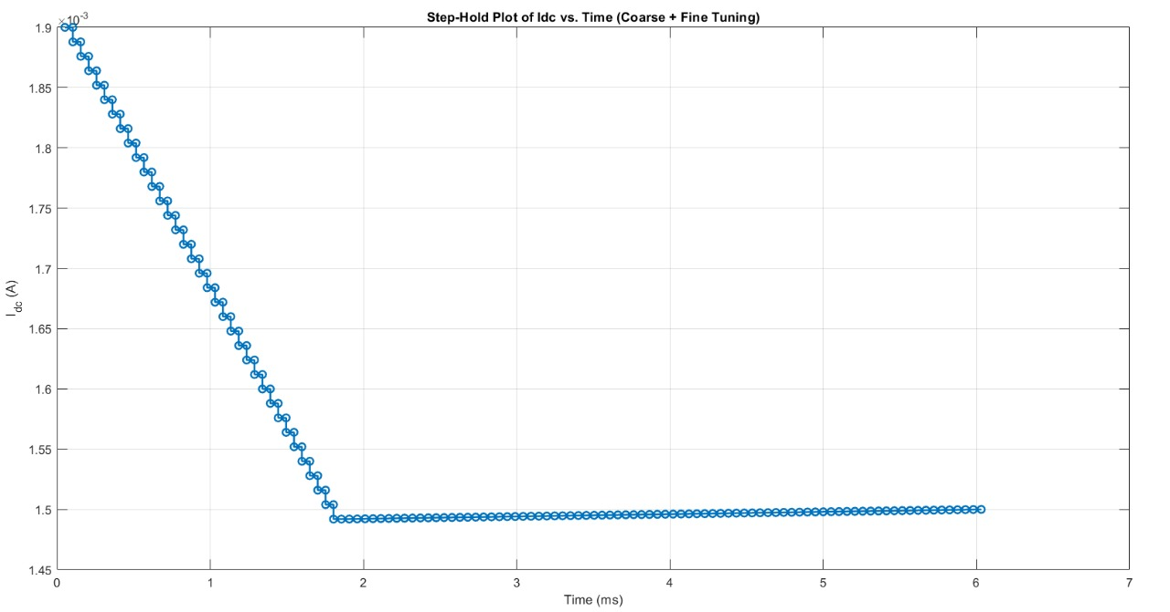
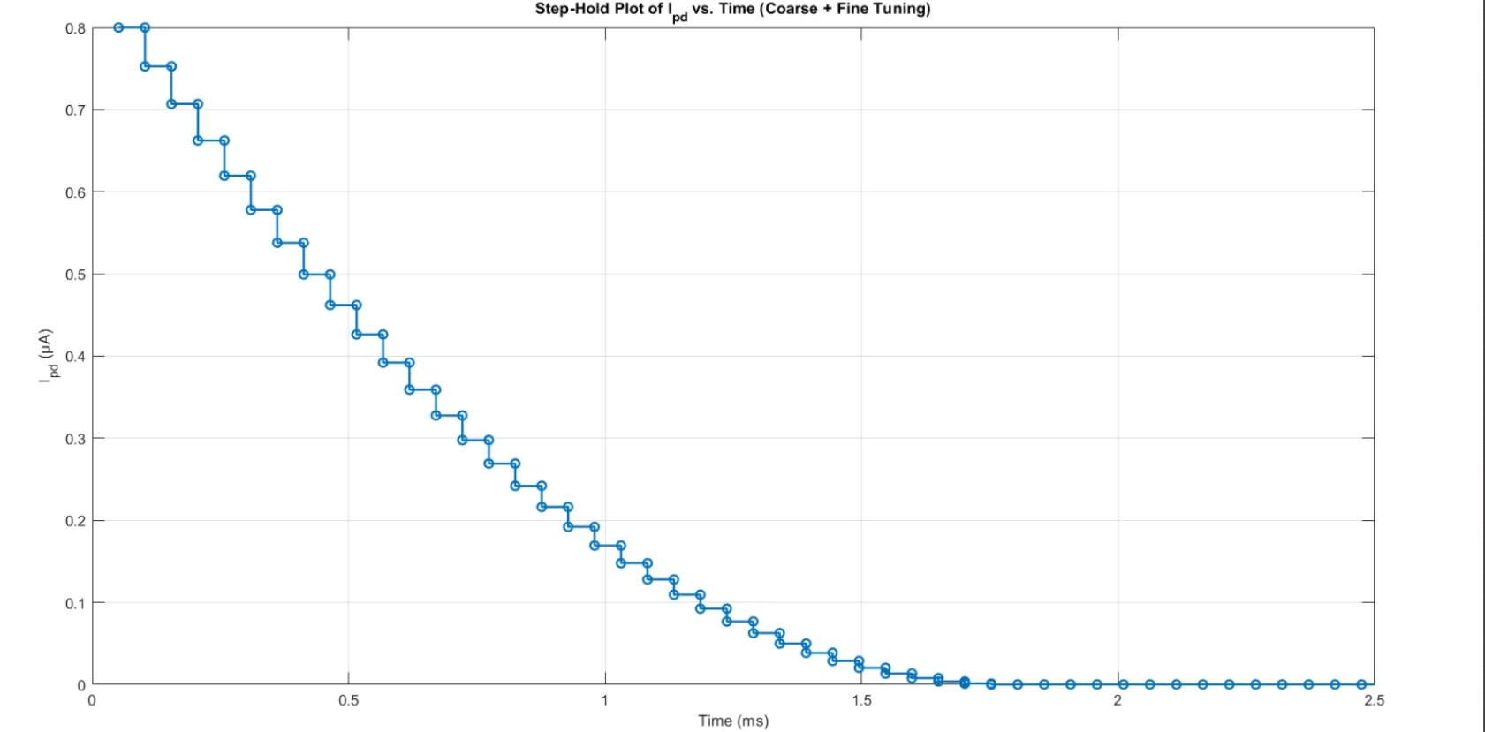
VCSEL Driver modulated waves from CP301
Fig.2 MATLAB simulation of I_{DC} with time as each loop iterates
Fig.3 MATLAB simulation of I_{PD} with time as each loop iterates
I_{PD} = 5(I_{DC}-1.5mA)²

Slide 6
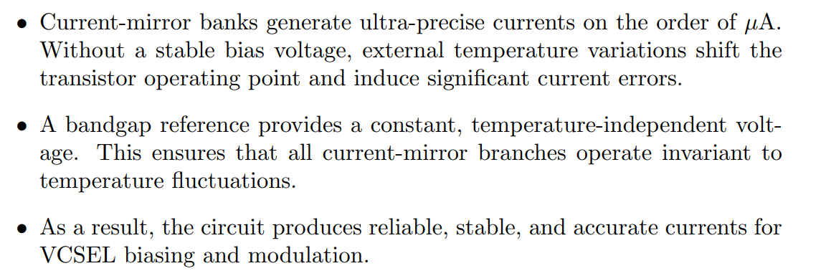
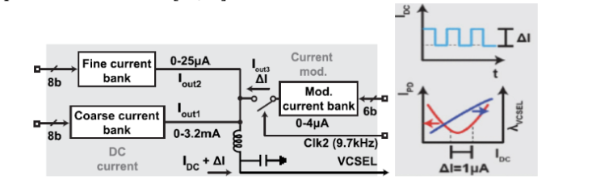
Need of Biasing Voltage for Current Mirror Banks
Fig.4 Current Banks in System Controller

Slide 7
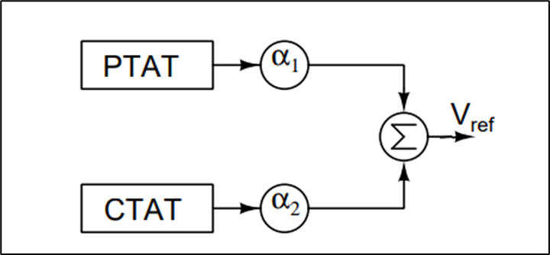
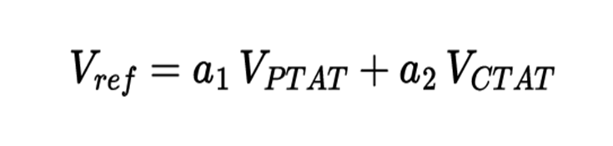
Need of BGR for Driver Module
A bandgap reference generates a stable output voltage that remains nearly constant across temperature variations by combining two complementary temperature coefficients.
The first term is a proportional-to-absolute-temperature (PTAT) voltage which increases with temperature. The second term is a complementary-to-absolute-temperature (CTAT) voltage , which decreases with temperature.
By scaling and summing these terms, the overall temperature dependence can be nulled.
We first implemented BGR as proposed in Banba et al., “A CMOS Bandgap Reference Circuit with Sub-1-V Operation,” IEEE JSSC, 1999.

Slide 8
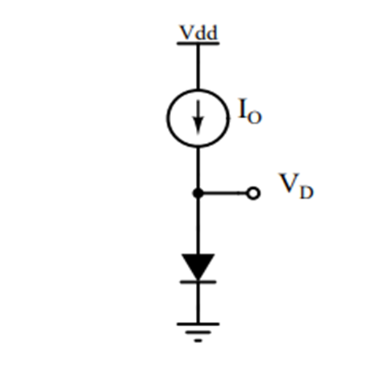
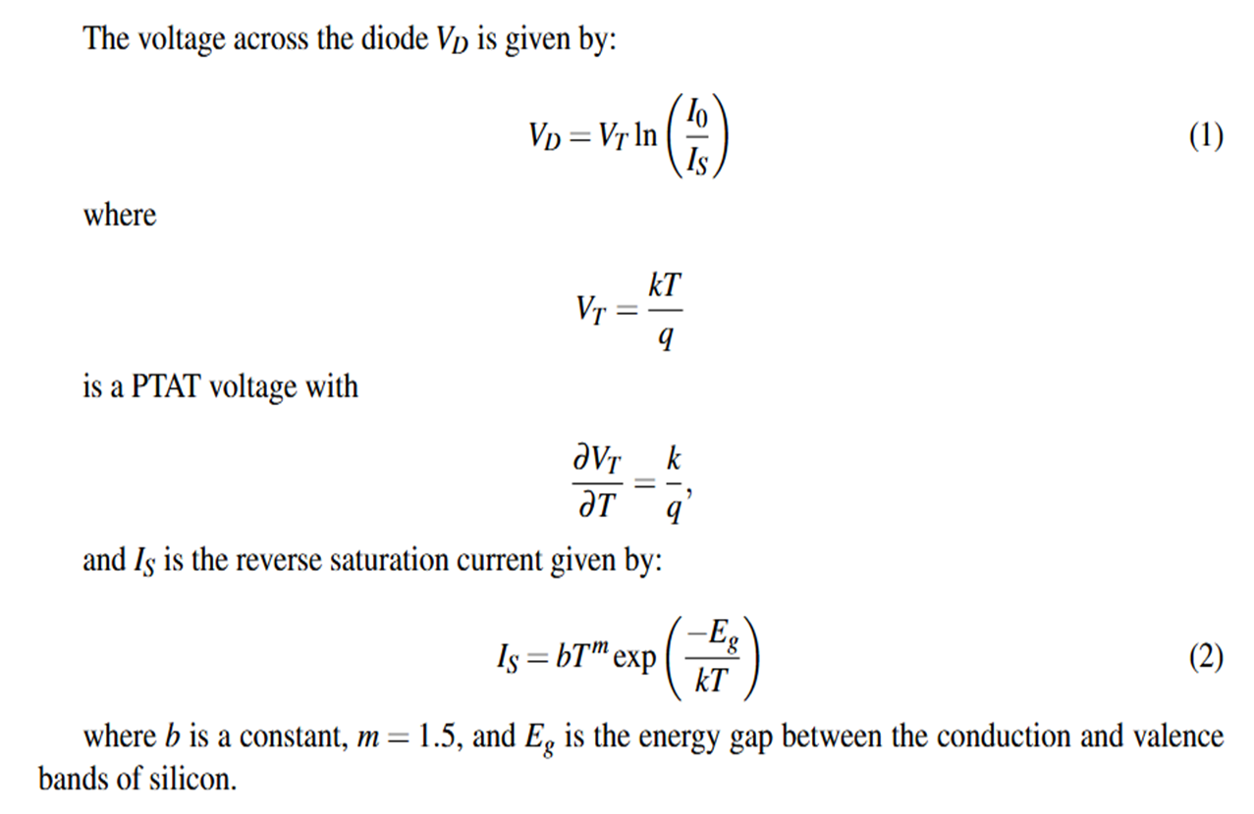
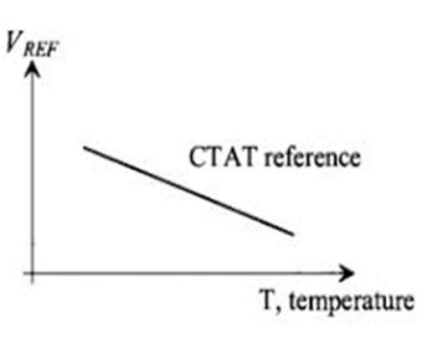
CTAT Circuit for H.Banba BGR
Fig.4 Diode CTAT Circuit [2]
B. Razavi, “The bandgap reference: A circuit for all seasons,” IEEE Solid-State Circuits Magazine [2]
Fig.5 Typical CTAT Temperature profile

Slide 9
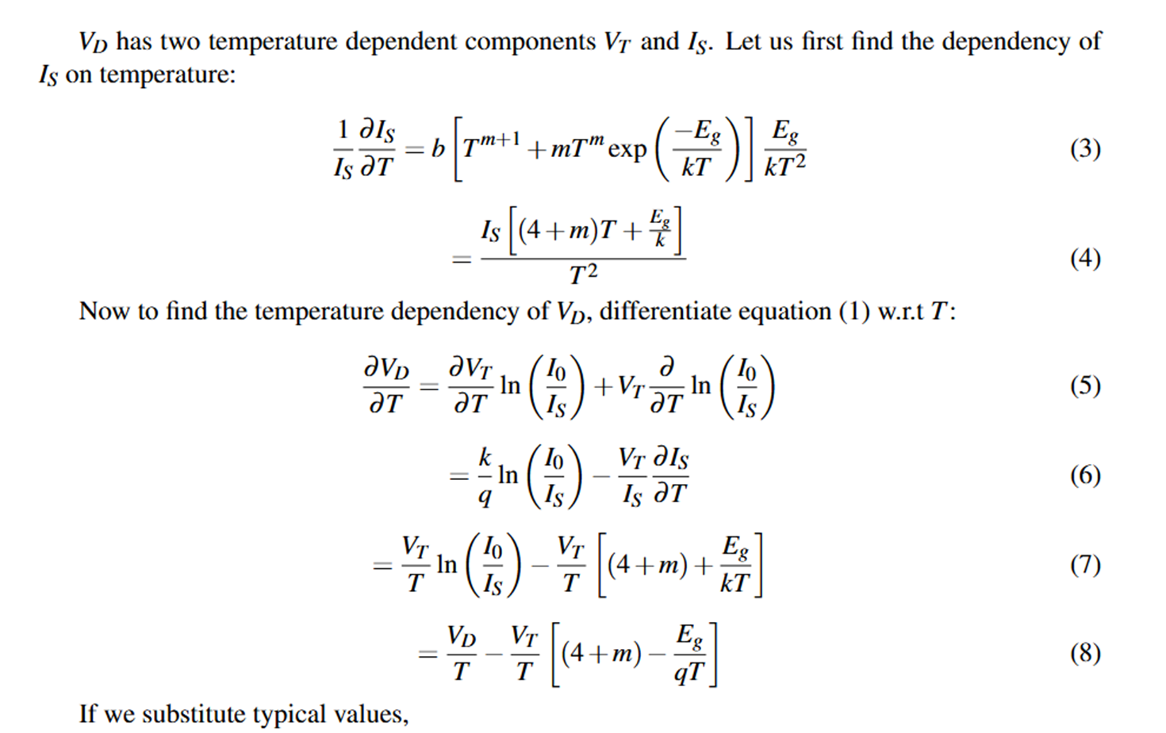
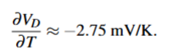
Reference[1]]:B. Razavi,“The bandgap reference: A circuit for all seasons,” IEEE Solid-State Circuits Magazine[2]

Slide 10
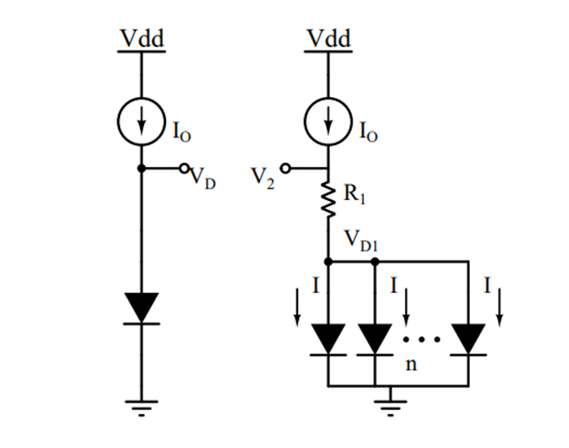
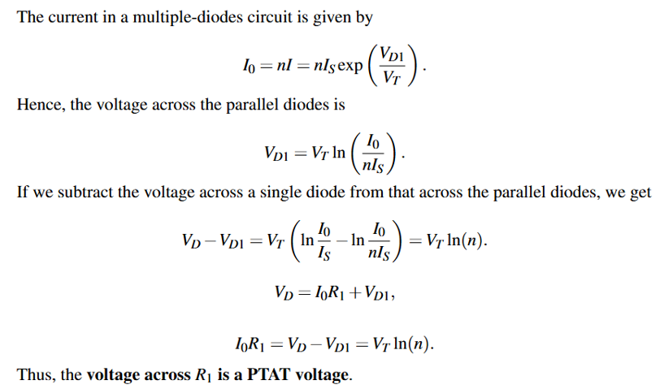
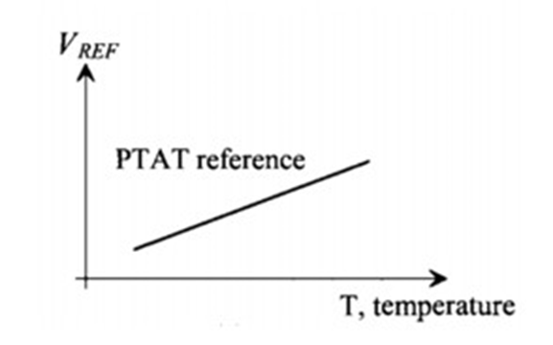
PTAT Circuit for Banba BGR
Fig.6 PTAT Circuit [1]
Reference: [1] H. Banba, H. Shiga, A. Umezawa, T. Miyaba, T. Tanzawa, S. Atsumi, and K. Sakui,
“A CMOS bandgap reference circuit with sub-1-V operation,” IEEE Journal of Solid-State Circuits
Fig.7 Typical PTAT Temperature profile

Slide 11
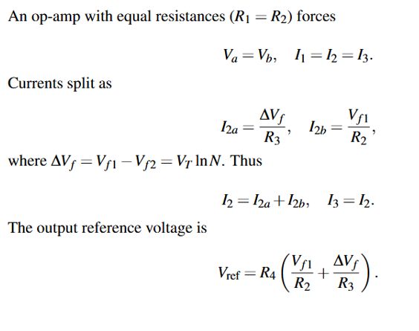
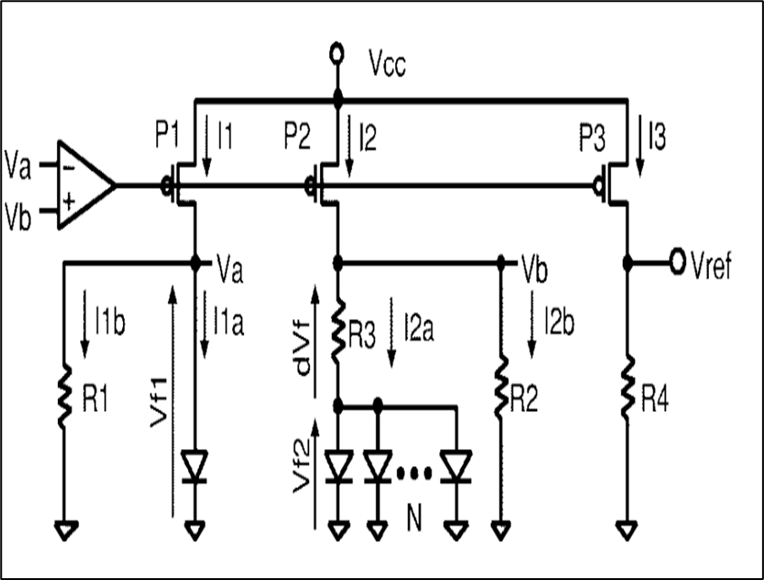
Bandgap Reference Circuit
Fig.8 Bandgap Reference Circuit [1]
Reference: [1]H. Banba, H. Shiga, A. Umezawa, T. Miyaba, T. Tanzawa, S. Atsumi, and K. Sakui,
“A CMOS bandgap reference circuit with sub-1-V operation,” IEEE Journal of Solid-State Circuits

Slide 12
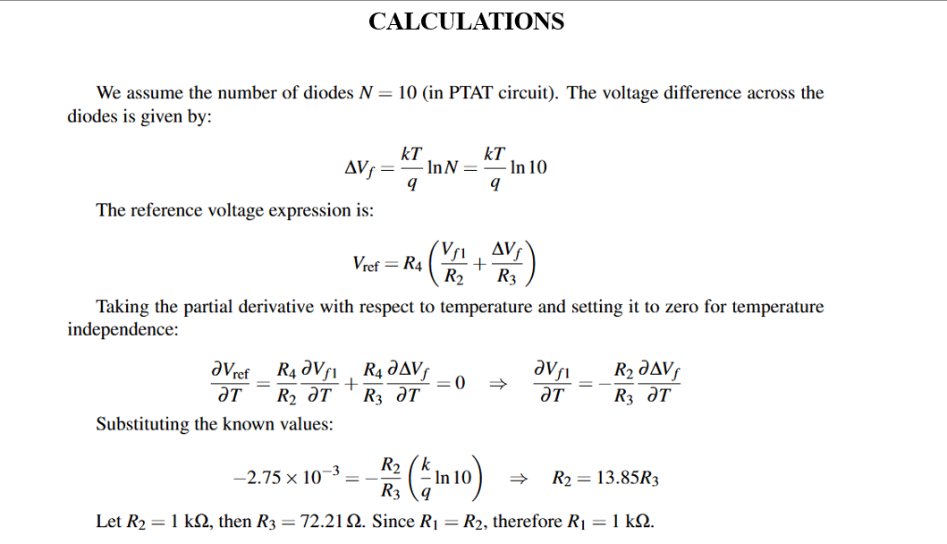

Slide 13
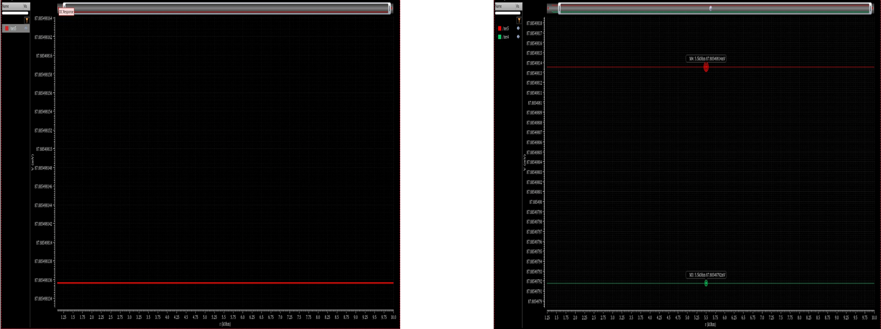
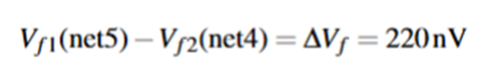
Plot of feedback voltages in Cadence
Fig.9
Fig 10.

Slide 14
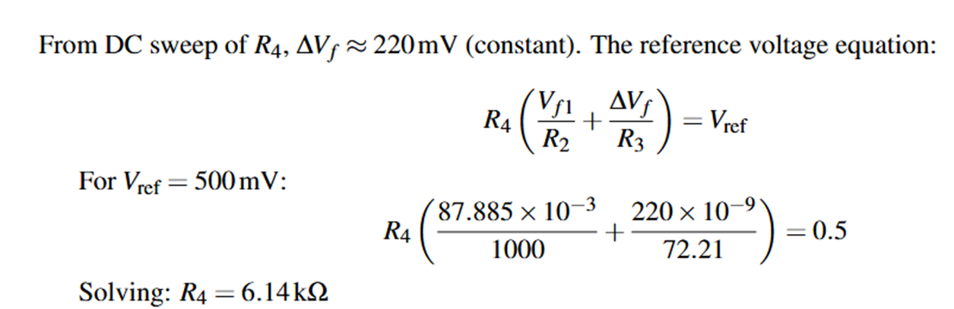
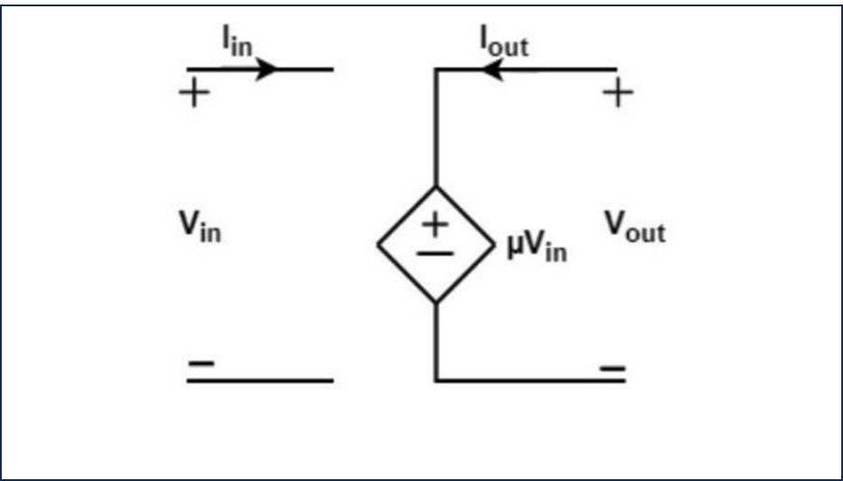
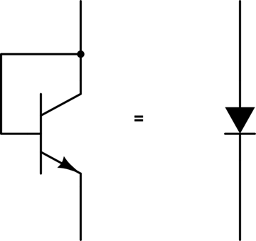
Fig.11 Diode connected BJT as a substitute to pn junction diode.
Fig.12 Ideal OP-Amp has been modelled as VCVS
We have taken a nominal gain of 40dB (i.e. 100V/V) for the op-amp

Slide 15
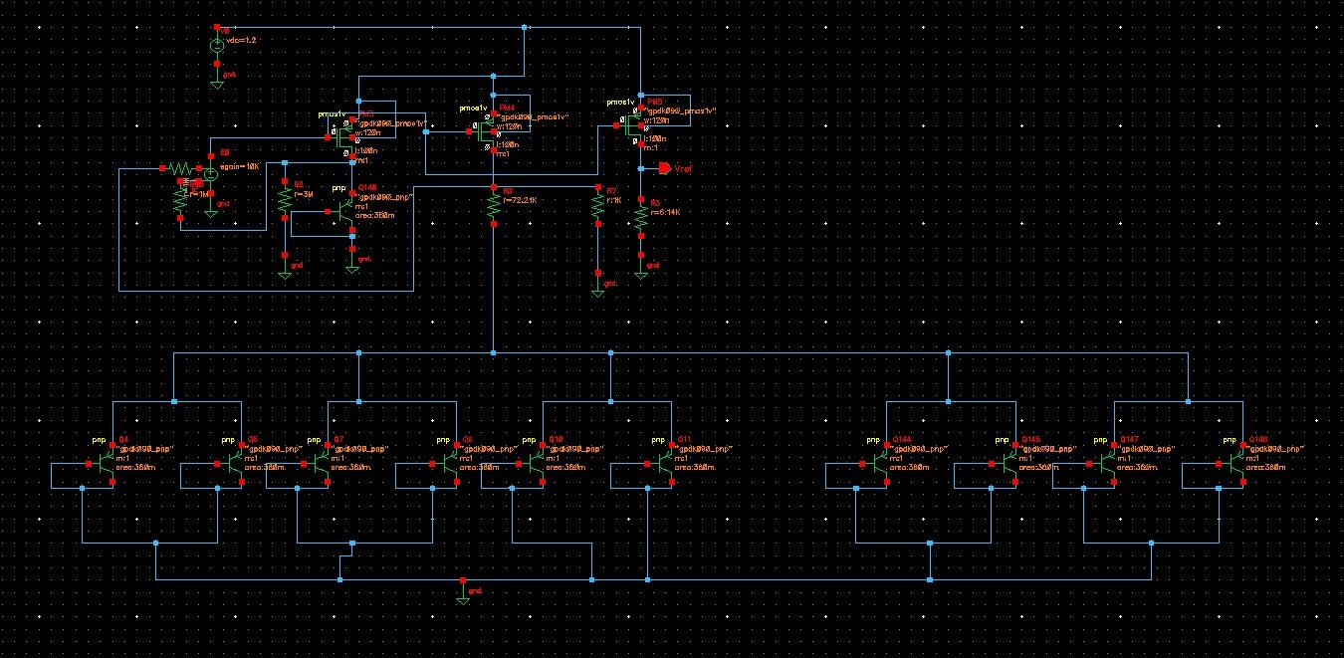
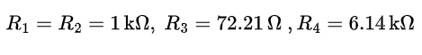
Schematic of BGR Circuit in Cadence

Slide 16
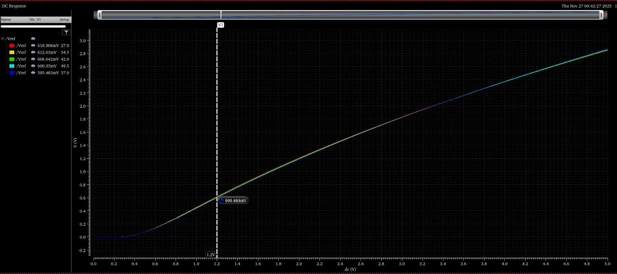
Parametric Plot of Reference Voltage vs Supply Voltage
Fig.14 Supply voltage being varied from 0V to 5V. At Vcc = 1.2V, we have got a nominal value of 0.6V independent of temperature

Slide 17
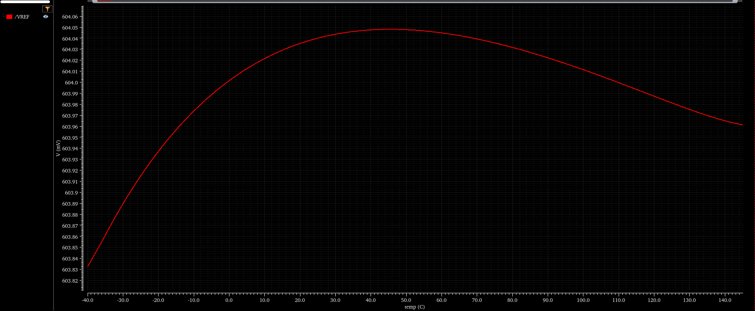
Temperature profile of BGR proposed by H. Banba^{[1]}
Fig.15 Dc Analysis of of Banba BGR’s Output Voltage varying with temperature

Slide 18
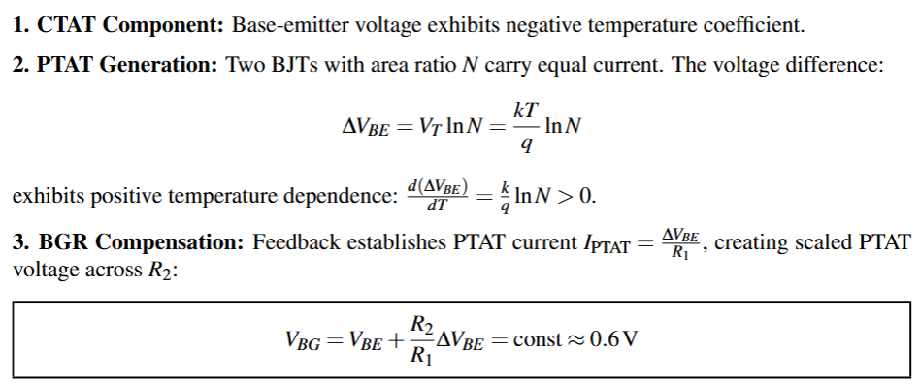
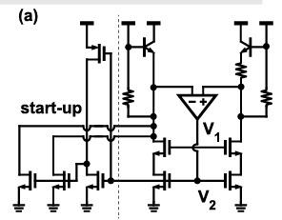
Op-amp Based BGR
Fig. 16 Op-amp based BGR[1]
Reference[1]]:B. Razavi,“The bandgap reference: A circuit for all seasons,” IEEE Solid-State Circuits Magazine[2]

Slide 19
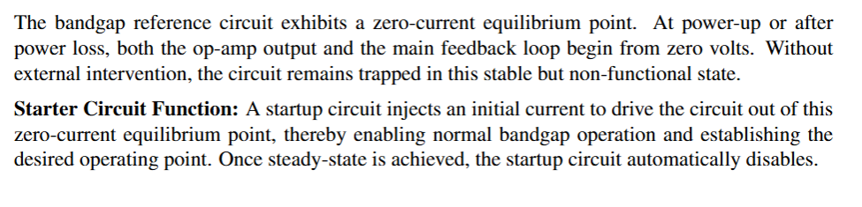
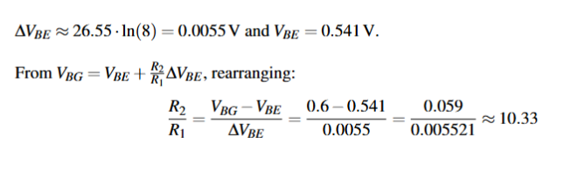
Necessity of Starter Circuit
Calculations:
Reference: [6] Robert J. Widlar “New Developments in IC Voltage Regulators,” IEEE Journal of Solid-State Circuits, Feb. 1971.

Slide 20
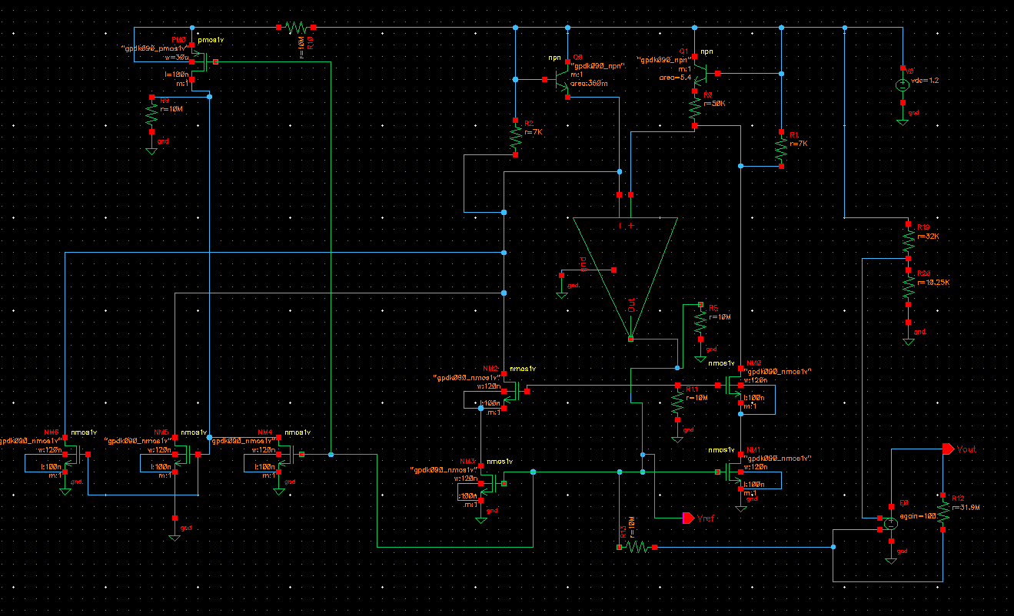
OTA Based BGR
Fig.17 Cadence Schematics of OTA Based BGR with Op-amp as an ideal VCVS of gain 100V/V

Slide 21
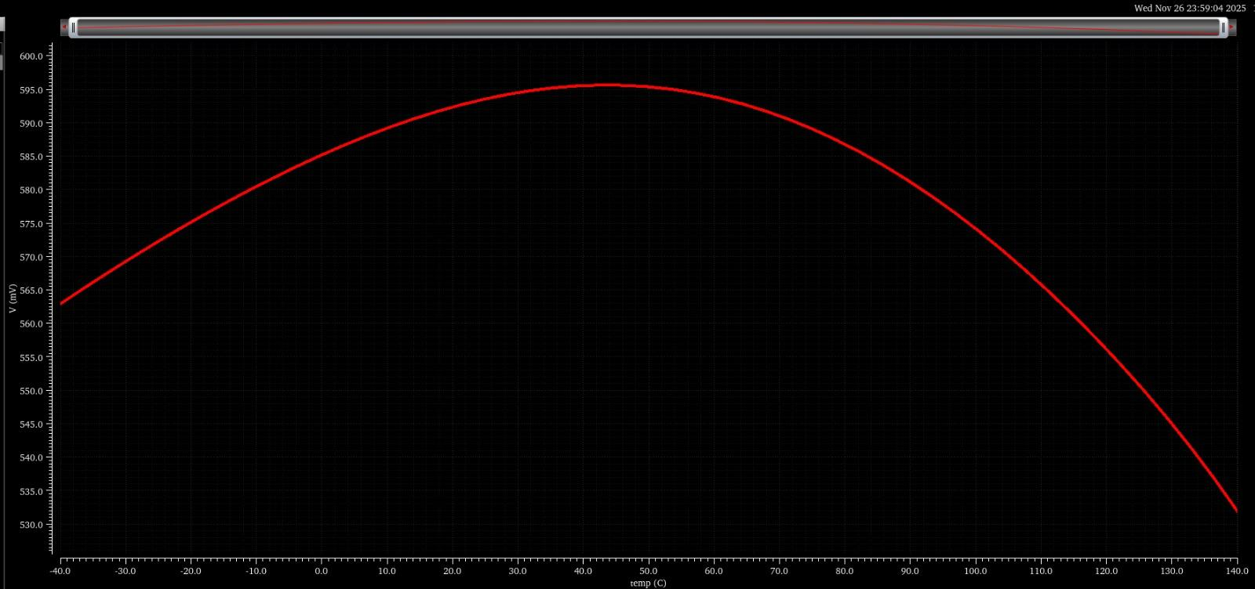
Reference Voltage Temperature Profile with Op-amp as an Ideal VCVS
Fig.18 Dc Analysis of Output Voltage of OTA Based BGR with gain set at 100V/V (or 40dB)

Slide 22
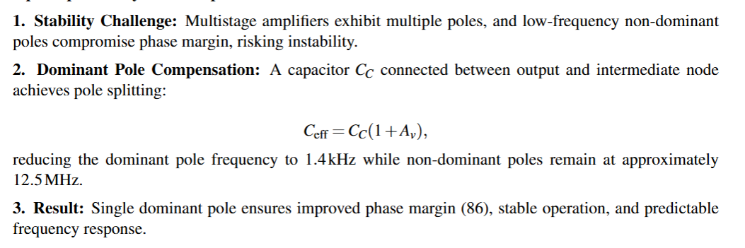
Miller Compensated 5T OTA Design
Need of miller compensation:

Slide 23
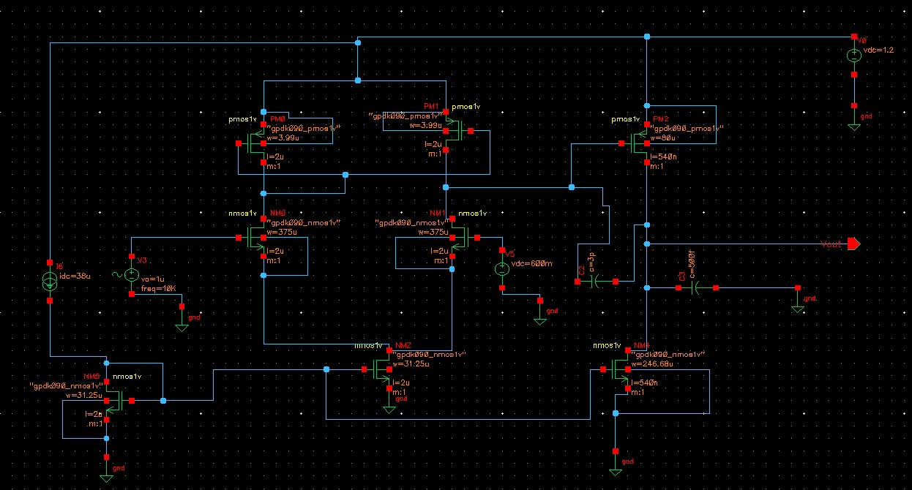
5T Op-Amp with Miller Compensation
Fig.19 Cadence Schematic of 5T OTA with miller capacitance of 3pF

Slide 24
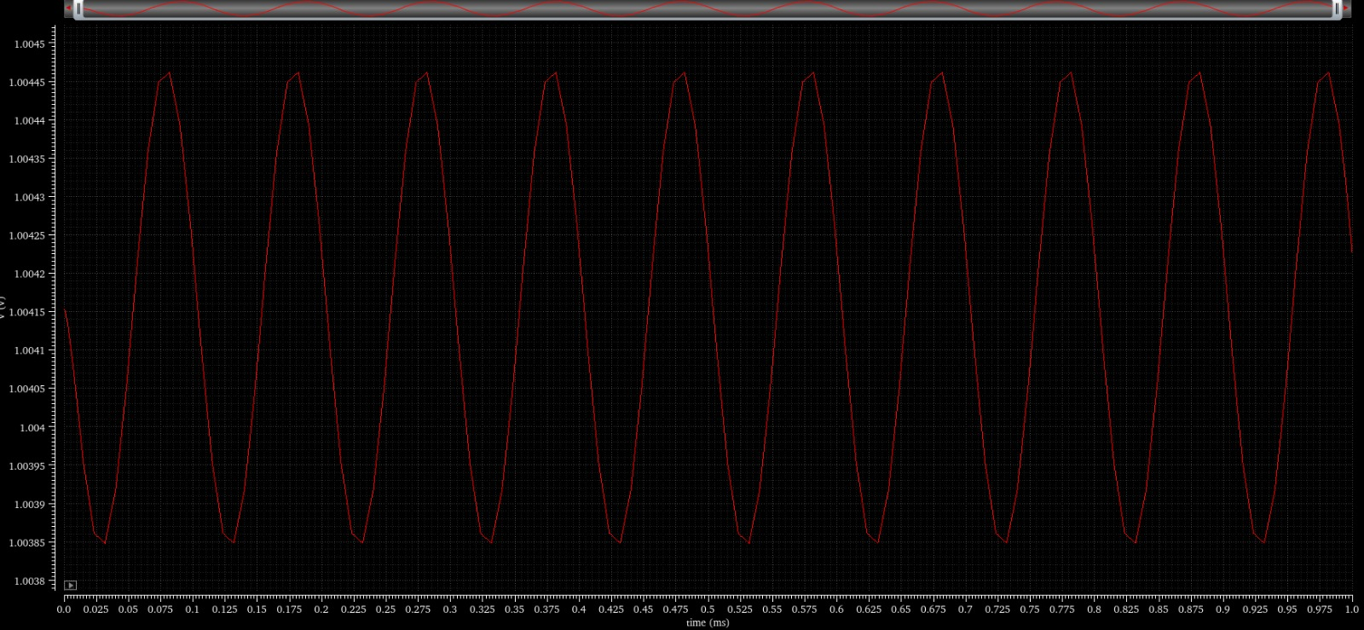
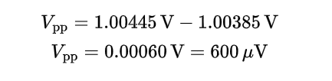
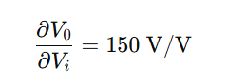
5T OTA Output Voltage Gain
Fig.20 Output voltage plot with time.

Slide 25
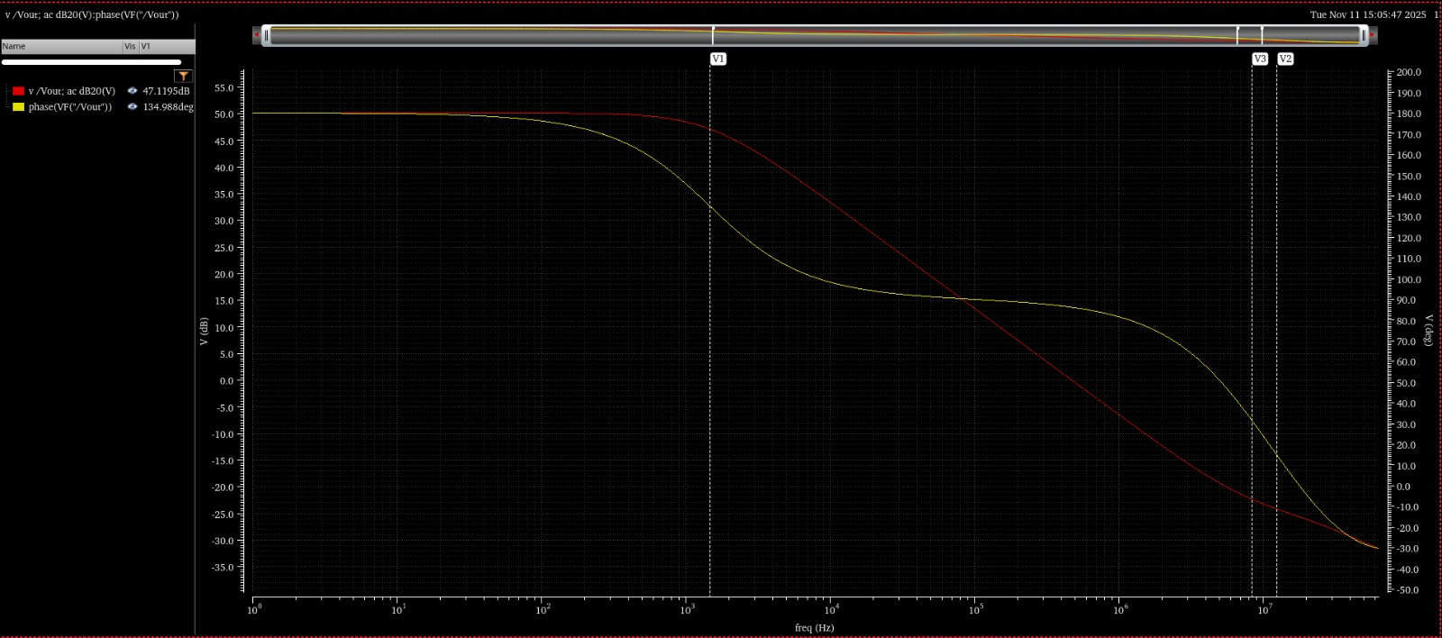
5T Op-Amp with Miller Compensation
Fig.21 Bode plot and phase plot showing p1 = 1.4 kHz, p2 = 12.52MHz & z1 = 8.35 MHz

Slide 26
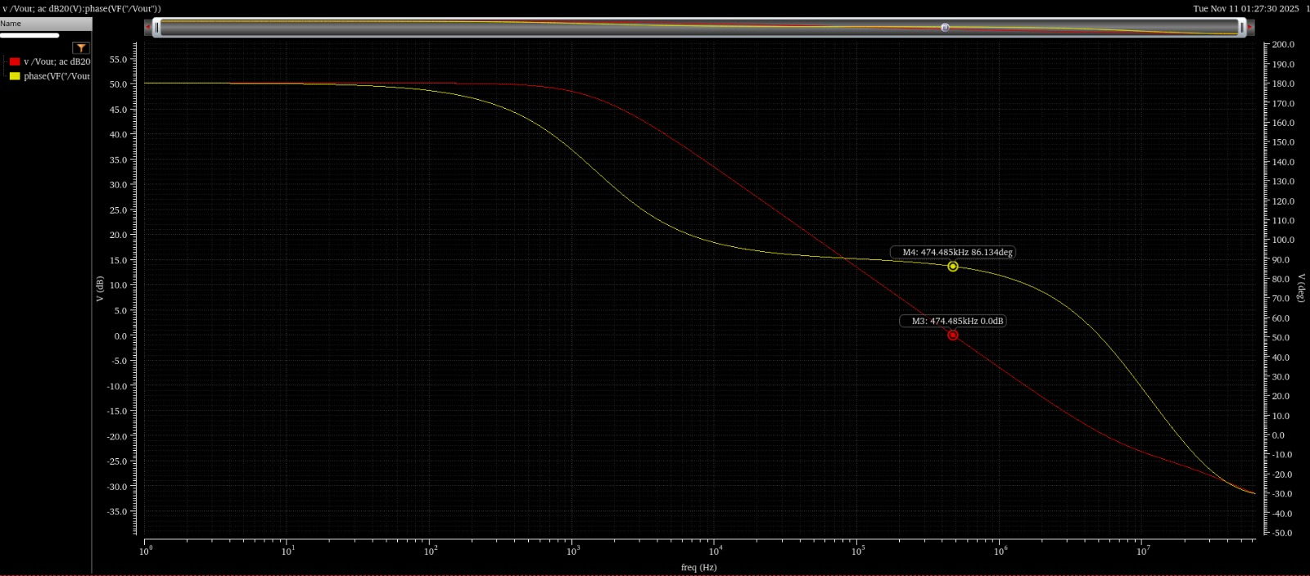
5T Op-Amp with Miller Compensation
Fig.22 Bode plot and phase plot of reference voltage showing gain crossover frequency of 0.47MHz and phase margin of 86.134º

Slide 27
Conclusion and Future Work
This work successfully designed and simulated the Banba-based bandgap reference circuit for the CSAC driver module. Through Cadence implementation, the BGR achieved stable 0.6V output voltage independent of temperature at 1.2V supply.
A 5T OTA with Miller compensation provided improved stability margins.
Further, we will be integrating the Miller compensated 5T-OTA in the op-amp based BGR circuit to deliver the precision voltage reference required for VCSEL driver stability in atomic clock applications

Slide 28
REFERENCES
[1] H. Banba, H. Shiga, A. Umezawa, T. Miyaba, T. Tanzawa, S. Atsumi, and K. Sakui,
“A CMOS bandgap reference circuit with sub-1-V operation,” IEEE Journal of Solid-State Circuits
[2] B. Razavi, “The bandgap reference: A circuit for all seasons,” IEEE Solid-State Circuits Magazine
[3] Azhar Yaseen, “Chip Scale Atomic Clock - Architecture Technical Report” [unpublished
manuscript as on 9th October 2025]
[4] H. Zhang et al., "29.4 Ultra-Low-Power Atomic Clock for Satellite Constellation with 2.2×10-12 Long-Term Allan Deviation Using Cesium Coherent Population Trapping," 2019 IEEE International Solid-State Circuits Conference - (ISSCC), San Francisco, CA, USA, 2019, pp. 462-464
[5] wikipedia.org/wiki/Bandgap_voltage_reference
[6] Robert J. Widlar “New Developments in IC Voltage Regulators,” IEEE Journal of Solid-State Circuits, Feb. 1971.

Slide 29


